Slide 1



AI FOR CROP DISEASE DETECTION

Slide 2
Problem Statement :
"Farmers can't always spot crop diseases early — by the time they know, it's too late. We need a smart system that can detect diseases just by looking at a leaf."

Slide 3
Aim of the Project
To build an AI system that detects crop diseases using leaf images.
To help farmers take early action.
To make detection easy and affordable.

Slide 4
Scope of the projects :
AI can help farmers detect crop diseases early.
It saves time, effort, and reduces losses.
In future, this can be made into a mobile app in local languages.

Slide 5
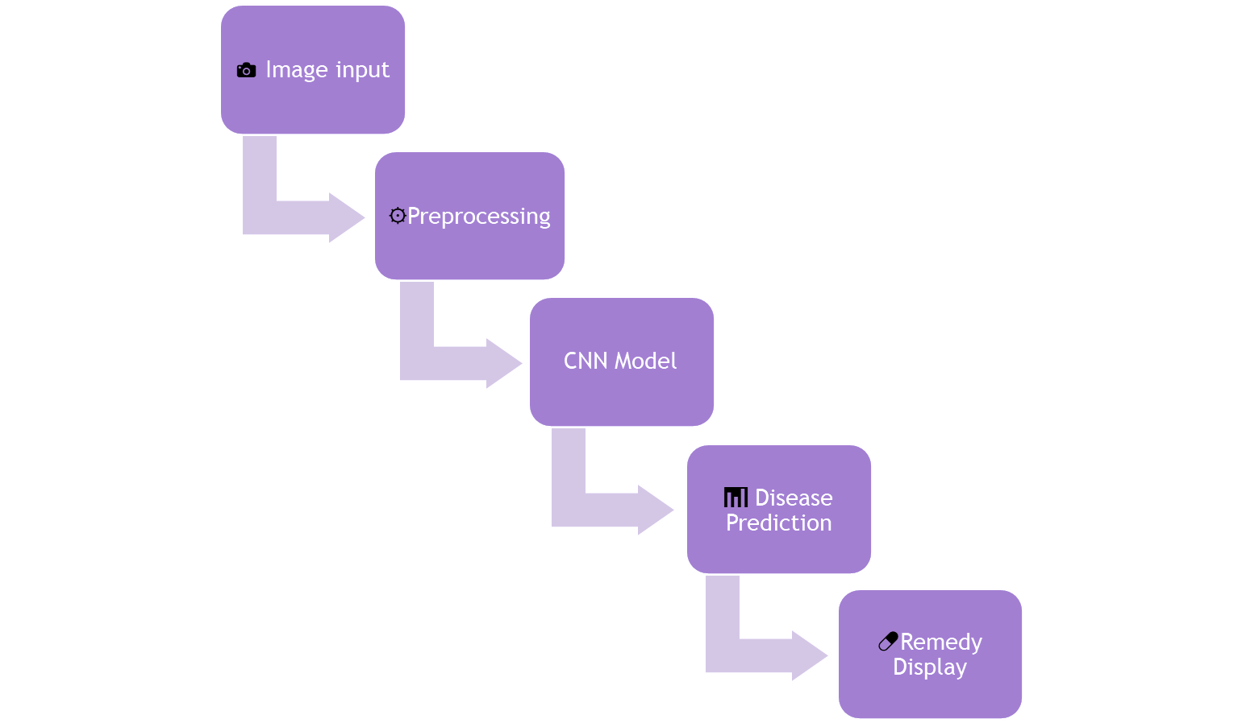
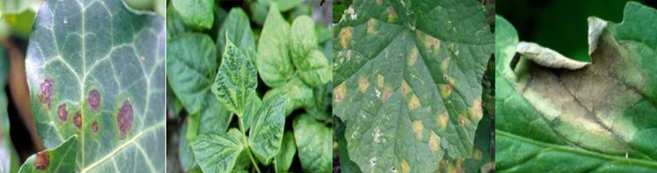
System Architecture
(a) Bacterial blemish (b) Viral Mosaic
(c) Late Blight
(d) Early Blight

Slide 6

Dataset Used:
PlantVillage Dataset (from Kaggle)
50,000+ labeled leaf images
14+ crop types and 30+ diseases
Technologies:
Python, TensorFlow, OpenCV
CNN/Transfer Learning
Django for Web App

Slide 7
References ::
1. PlantVillage Dataset on Kaggle
➤ https://www.kaggle.com/datasets/emmarex/plantdisease
2. TensorFlow Official Documentation (Used for AI model building)
➤ https://www.tensorflow.org/
3. Research Paper (Deep Learning for Plant Disease Detection)
➤ Mohanty, S. P., Hughes, D. P., & Salathé, M. (2016)
Using Deep Learning for Image-Based Plant Disease Detection
➤ https://arxiv.org/abs/1604.03169
4. OpenCV (Image Processing Library)
➤ https://opencv.org/about/

Slide 8
THANK YOU!!

